Slide 1
BUILDING MATERIALS AND CONCRETE TECHNOLOGY
B.Tech 2nd Year (IV Semester)

Slide 2
UNIT -2 CONTENTS
BUILDING COMPONENTS
Lintels, Arches and Vaults, staircases – types.
Different types of flooring – concrete, Mosaic, Terrazo floors,
Different types of roofs – Pitched, Flat and curved roofs, lean to roof, coupled roofs, trussed roofs, king and queen post trusses.
Doors and windows – types and sizes.

Slide 3
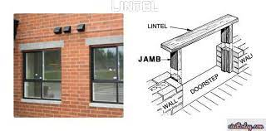
LINTELS
lintel is one type of beam which is utilized to support the above wall or partition material when openings like doors, windows.
The primary function of the lintel is to take loads originating from the high wall and transfer its heap to the side walls.

Slide 4
Types of lintels
wood or timber lintels
Stone lintels
Brick lintels
Steel lintels
Reinforced cement concrete lintels

Slide 5
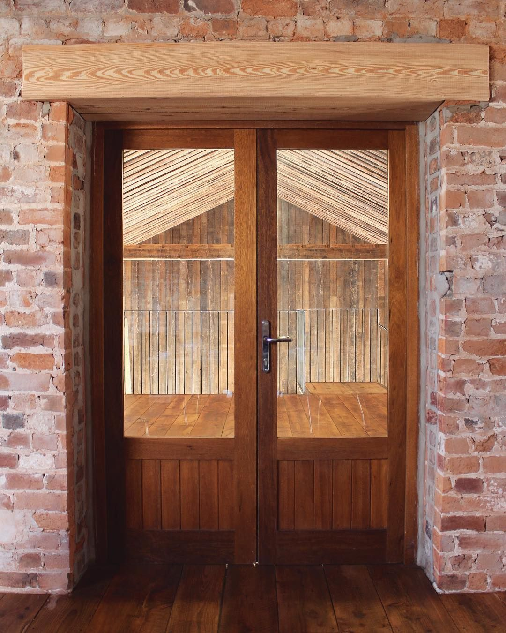
Wood or timber lintels
These lintels consists of pieces of timber which are placed across the opening.

Slide 6
The important features of wood lintels are as follows
A bearing of about 150 mm to 200 mm should be provided on the wall and the ends of lintels should be placed on mortar so as to create a level and firm bearing.
The width of lintel should be equal to thickness of the opening and the depth of lintel should be about 1/12 to 1/8 of the span with a minimum value of 80mm.
The wood lintels are liable to be destroyed by fire and also are liable to decay If not properly ventilated. Hence sound and hard timber like teak should be used in the construction of wood lintels and a coat of suitable preservative should be applied.

Slide 7
The wood lintels help in securing the heads of frames of timber doors and windows.
If wood lintels is to be used for larger spans, it is necessary to design it as a timber beam simply supported at its end.

Slide 8
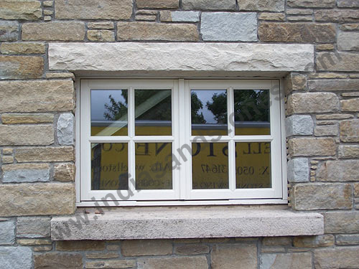
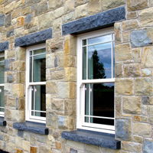
Stone lintels
These lintels consists of slabs of stones which are placed across the openings.
The stone lintels may be formed of a single piece or more than one piece.

Slide 9
The stone lintels are not favoured mainly due to the following reasons:
the stone possesses low tensile resistance. Hence the relieving arches are to be provided when the span exceeds 1m.
The stone cracks when subjected to vibratory loads. Hence the stone lintels should be used with caution where shock waves are likely to occur frequently.
It is difficult to obtain a good stone of required depth. Hence the stone lintels prove to be costly at places where the stone is not available.
The stones which are to be used for lintels are to be properly dressed on site of work. This will increase the cost of work.

Slide 10
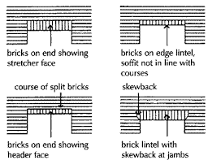
Brick lintels
These lintels consists of bricks which are generally placed on end or edge.

Slide 11
Important features are as follows
the bricks should be well burnt.
a brick lintel is weak form of construction and hence it is suitable upto a span of 1m with light loading.
Depending upon the span their depth varies from 10 cm to 20 cm and at end joints, bricks with frogs filled with mortar give more shear resistance.

Slide 12
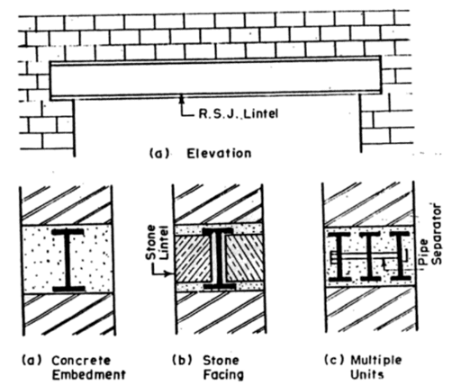
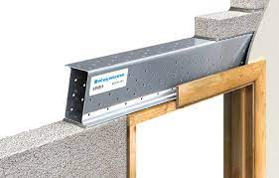
Steel lintels
These lintels consists of steel angles or rolled steel joists.
These are used for large spans and heavy loading.

Slide 13
Reinforced cement concrete lintels
These lintels consists of the reinforced cement concrete,
The RCC lintels are fire proof, durable, strong, economical and easy to construct.
The usual concrete mix for RCC lintel is 1:2:4.

Slide 14
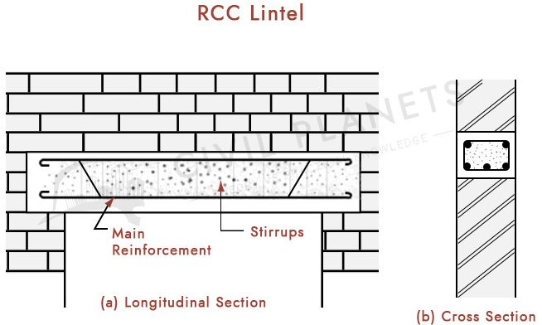
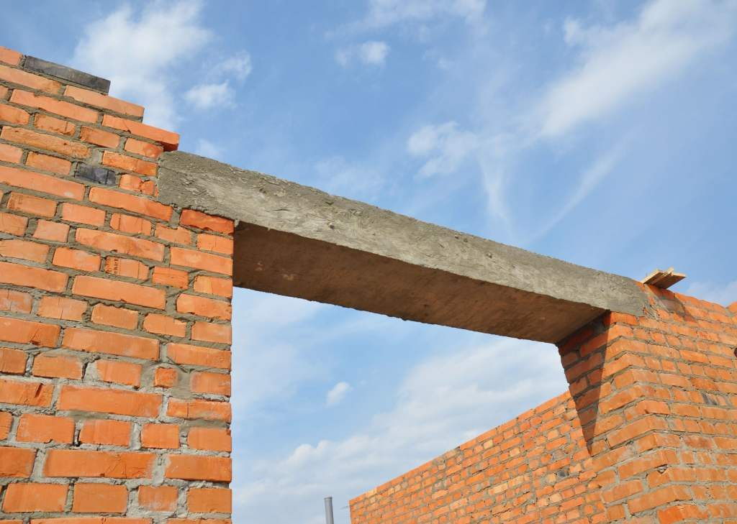

Slide 15
ARCHES
An arch is a structure which is constructed to span across an opening. It generally consists of small wedge shaped units which are joined together with mortar.
Arches made of steel and RCC are built in single units without the uses of wedge shaped units and they are used for bridge construction.

Slide 16
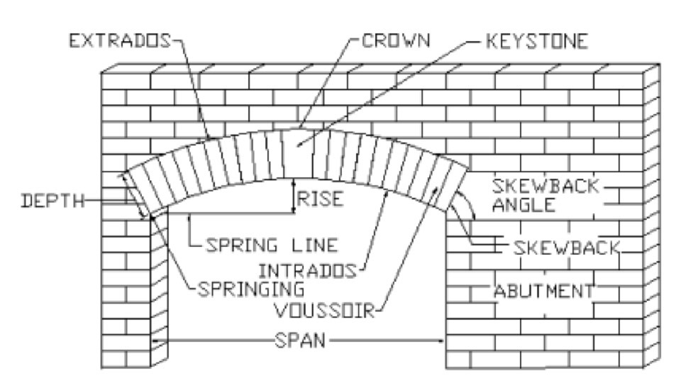
SEGMENTAL ARCH

Slide 17
Technical terms:
Intrados
Soffit
Extrados
Voussoirs
Skewback
Springer
crown
Key
Abutment
Piers
Springing points
Springing line
Span
Rise
Centre
Ring
Depth or height
Spandril
Haunch
Arcade
Thickness or breadth of soffit
impost

Slide 18
TYPES OF ARCHES
Classification of arches according to shape
Classification of arches according to number of centres
Classification of arches according to workmanship
Classification of arches according to materials of construction

Slide 19
ACCORDING TO SHAPE
Flat arch
Segmental arch
Semi-circular arch
Semi-elliptical arch
Inverted arch
Pointed arch
7. Relieving arch
8. Horse shoe arch
9. Stilted arch
10. Venetian arch
11. Florentine arch

Slide 20
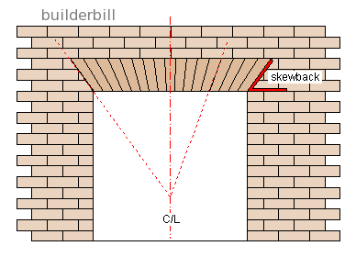
FLAT ARCH
The apparent shape of this arch is flat
and usually the skewback forms an angle
of 60° with the horizontal as shown.

Slide 21
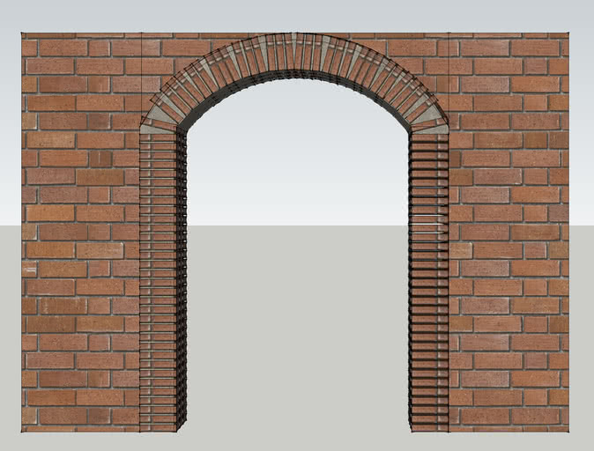
SEGMENTAL ARCH
This is the common type of arch used for buildings.

Slide 22
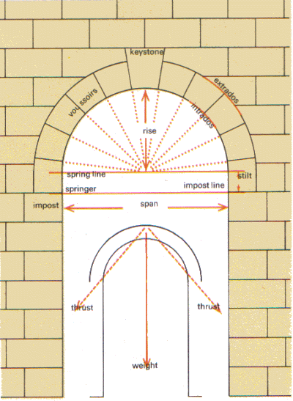
SEMI-CIRCULAR ARCH
The centre of the arch lies on the springing line and the shape of curve is a semi-circle.

Slide 23
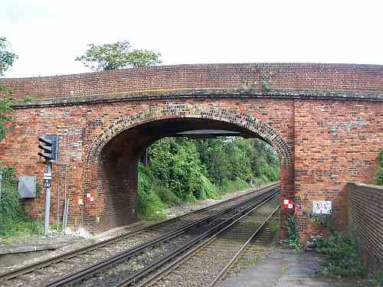
SEMI-ELLIPTICAL ARCH
This arch has more than one centre and its shape is that of a semi ellipse. It may have either three or five centres.

Slide 24
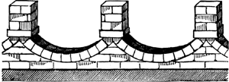
INVERTED ARCH
This arch is constructed to increase the bearing power of the soil.

Slide 25
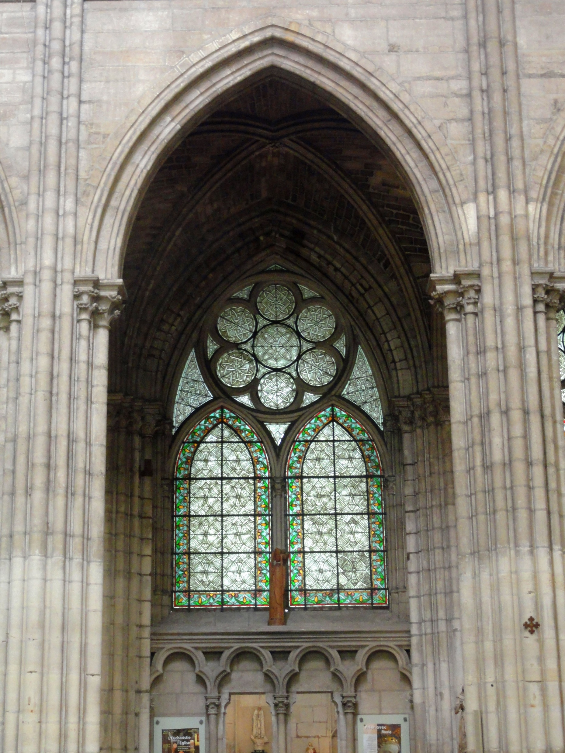
POINTED ARCH
This type of arch consists of two curves which are meeting at the apex of a triangle. The triangle formed may be equilateral or isosceles.

Slide 26
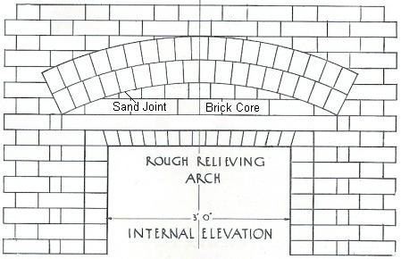
RELIEVING ARCH
When wooden lintel is proved over the wider opening, a brick relieving arch is constructed above the lintel.
Relieving the load of the masonry over lintel.

Slide 27
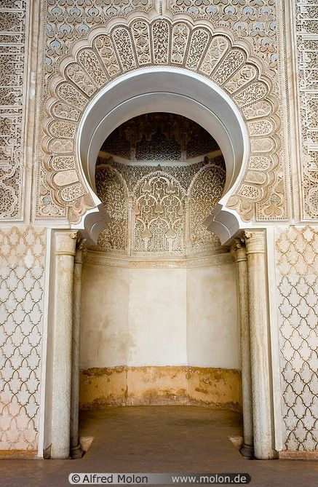
HORSE SHOE ARCH
Has the shape of a horse shoe.
It is mainly adopted from architectural considerations.
The shape of the arch includes more than a semi circle.

Slide 28
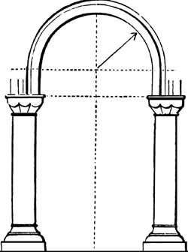
STILTED ARCH
Has a semi circular shape attached at the top of two vertical portions. The springing line of the arch passes through the tops of vertical portions.

Slide 29
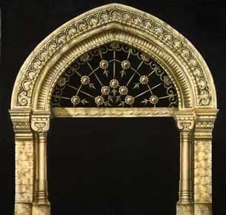
VENETIAN ARCH
This is another form of pointed arch.
Has deeper depth at crown than springing.
It has four centres located on springing line.

Slide 30
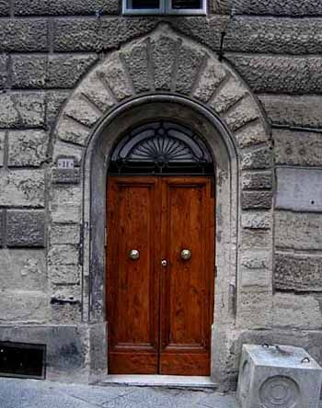
FLORENTINE ARCH
This is similar to Venetian Arch
Its intrados is a semicircle
It has three centres located on springing line.

Slide 31
CLASSIFICATION ACCORDING TO NUMBER OF CENTRES
ONE CENTRED ARCH
TWO CENTRED ARCH
THREE CENTRED ARCH
FOUR CENTRED ARCH
FIVE CENTRED ARCH

Slide 32
ONE CENTRED ARCH
Has one centre only.
The flat, segmental, semi – circular, horse shoe and stilted arches are one centred.

Slide 33
TWO CENTRED ARCH
This type of arch has two centres.
A pointed arch is a good example.

Slide 34
THREE CENTRED ARCH
Has three centres.
It is in the form of a semi ellipse
Other example is Florentine arch.

Slide 35
FOUR CENTRE OR TUDOR ARCH
This has four centres.
It consists of two different curves and has the appearance of an ellipse at the haunches.
The venetian arch is an example for this type of arch

Slide 36
FIVE CENTRED ARCH
This type of arch has got five centres and it looks nearly like a semi elliptical arch.
Draw the springing line PQ and divide it into five equal parts.
With centres as P and Q draw arcs of radius equal to the span, meeting each other at point c. join point c with R and S.
With centres as a and e, draw arcs of radius equal to three divisions meeting each other at point M.
Join points a and M the point of intersection of lines aM and cR is point b. similarly d will be the point of intersection of lines eM and cS.
The points a, b, c, d and e represent five centres of the arch.

Slide 37
CLASSIFICATION OF ARCH ACCORDING TO WORKMANSHIP
ROUGH ARCH
AXED OR ROUGH CUT ARCH
GAUGED ARCH

Slide 38
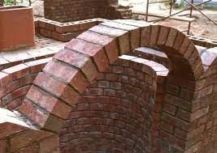
ROUGHED ARCH
Constructed from ordinary uncut bricks.
The mortar joints become wider at the extrados than at the intrados.
Such arches are constructed in rings of half bricks. A rough arch is used where appearance is of secondary importance or when it is intended to plaster the face of the arch.

Slide 39
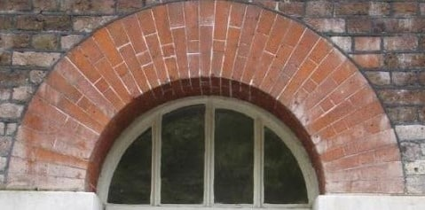
AXED OR ROUGH CUT ARCH
Made with wedge shaped bricks
Joints are of uniform thickness.
Not so attractive due to wedge shaped bricks which are not finely dressed.

Slide 40
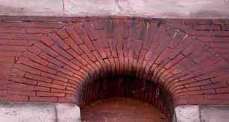
GAUGED ARCH
Made with bricks which are prepared to exact size and shape of voussoir.
Joints are fine, thin and truly radial
Lime putty is used as a binding material.

Slide 41
CLASSIFICATION OF ARCHES ACCORDING TO MATERIAL OF CONSTRUCTION
STONE ARCHES
BRICK ARCHES
CONCRETE ARCHES

Slide 42
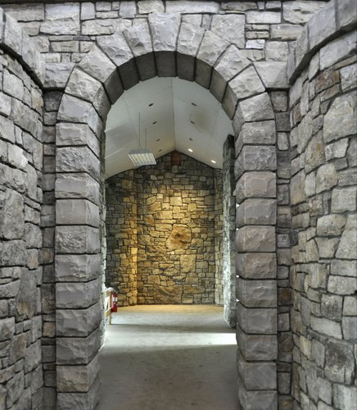
STONE ARCHES
Constructed in the rubble masonry or ashlar masonry.
The rubble masonry arch is comparatively weak and hence it is used for inferior type of work.

Slide 43
BRICK ARCHES
These arches can be constructed from ordinary bricks or purpose made bricks or soft bricks.
The ordinary bricks are not cut to the shape of voussoirs and hence the rough brick arches are formed.
The purpose made bricks are special bricks of different sizes which are suitable for arch work.
The soft bricks are manufactured from special material and they can be easily cut, sawn and rubbed to the desired shape. These are also known as rubber brick.

Slide 44
CONCRETE ARCHES
These arches can be constructed of the pre-cast cement concrete blocks or monolithic concrete.
The monolithic concrete arches are constructed from the cast-in-situ concrete and are suitable for big spans.
They are employed in the construction of culverts and bridges.

Slide 45
STAIRCASE
A stair is defined as a sequence of steps and it is provided to afford the means of ascent and descent between the floors or landing.

Slide 46
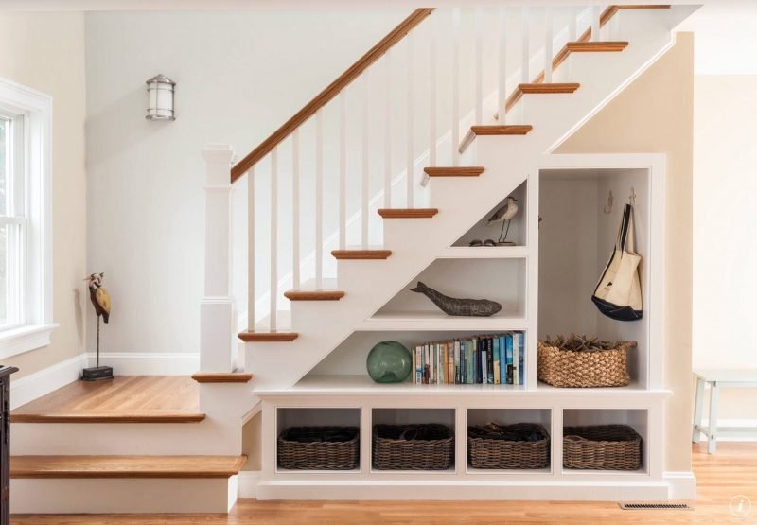

Slide 47
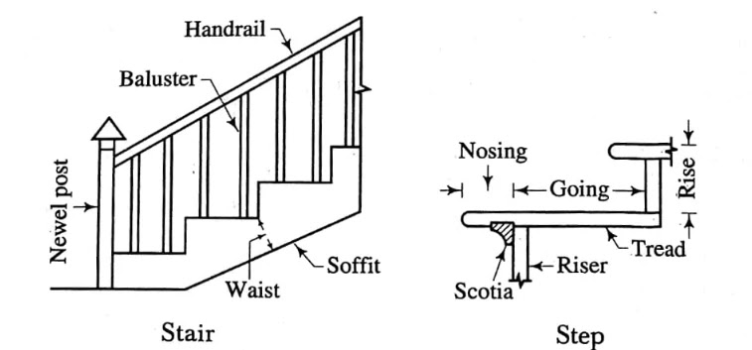
TECHNICAL TERMS
Baluster 10. Rise 13. Soffit 16. Tread
Flight 11. Run 14. step 17. Walking line
Going 12. Scotia 15. Waist
Handrail
Headroom
Landing
Newel post
Nosing
Pitch

Slide 48
TYPES OF STAIRS
Straight stairs
Turning stairs
Circular or helical or spiral stairs
Geometrical stairs

Slide 49
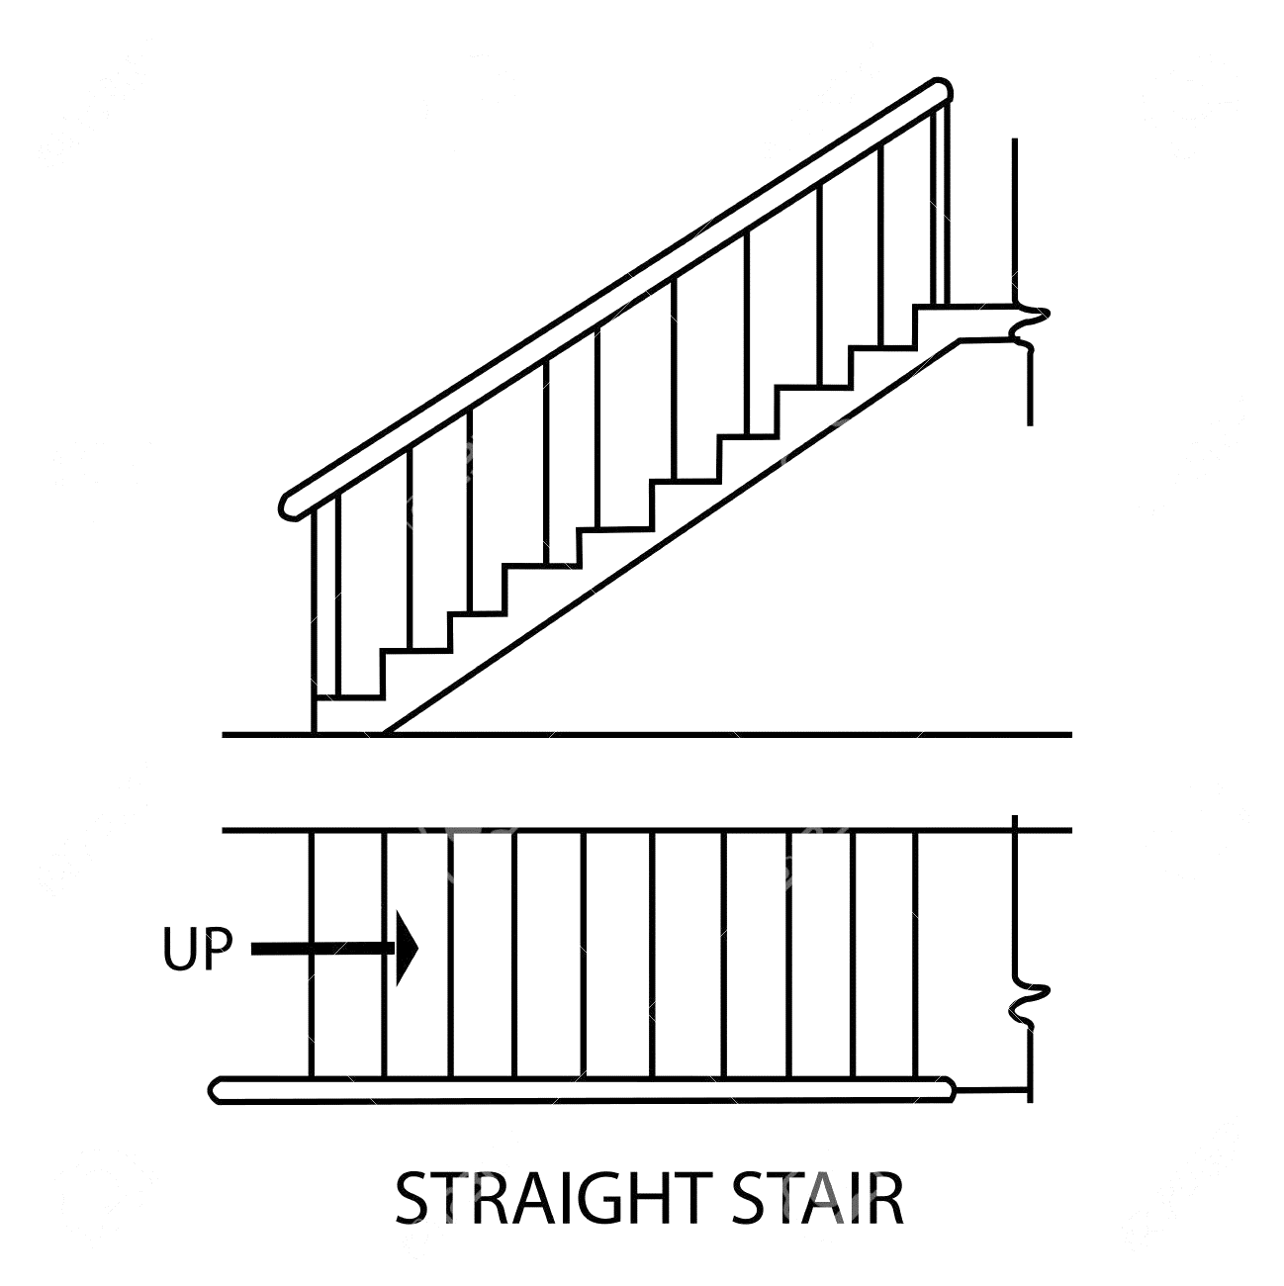
Straight stairs
All steps lead in one direction only.
Has one or more flights when the space available for staircase is long but narrow in width.

Slide 50
TURNING STAIRS
The flights take turn.
Types of turning stairs:
Quarter turn stairs
Half turn stairs
Three quarter turn stair

Slide 51
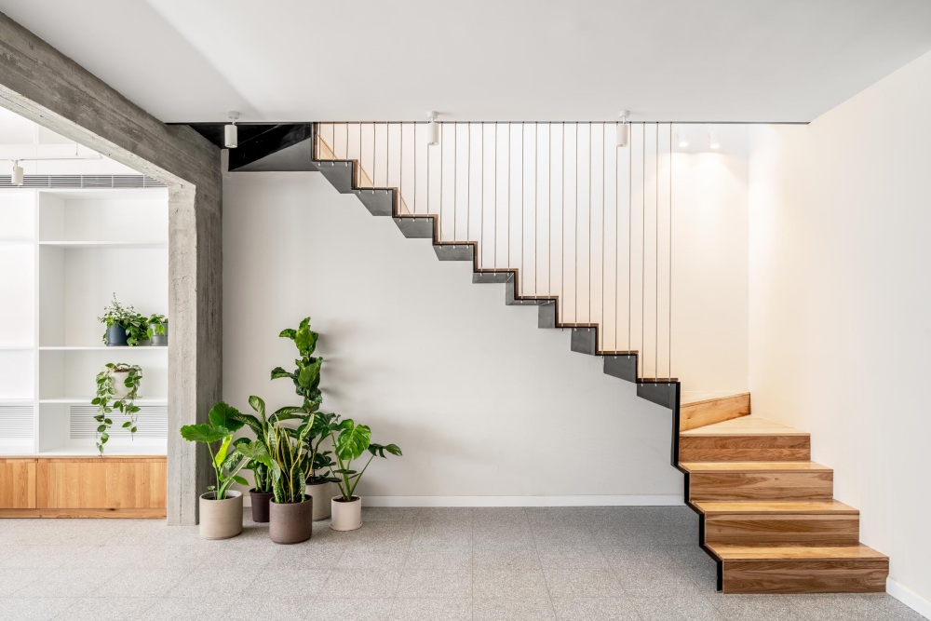
Quarter-turn stairs:
A stair turning through right angle is known as quarter turn stair.
It is also known as bifurcated stair.
This type of stair is commonly used in the public building near their entrance hall.

Slide 52
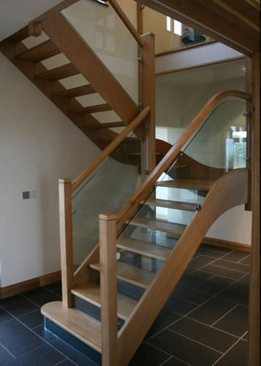
Half –turn stairs
Two or more flights
Directions reversed at next floor
Direction change facilitated by landing
Landing width may be equal to width of stair wall
Steps/winders may also be used instead of landing
More or less equal risers in two main flights
Most common types of stair
Dog- legged or open newel stairs

Slide 53
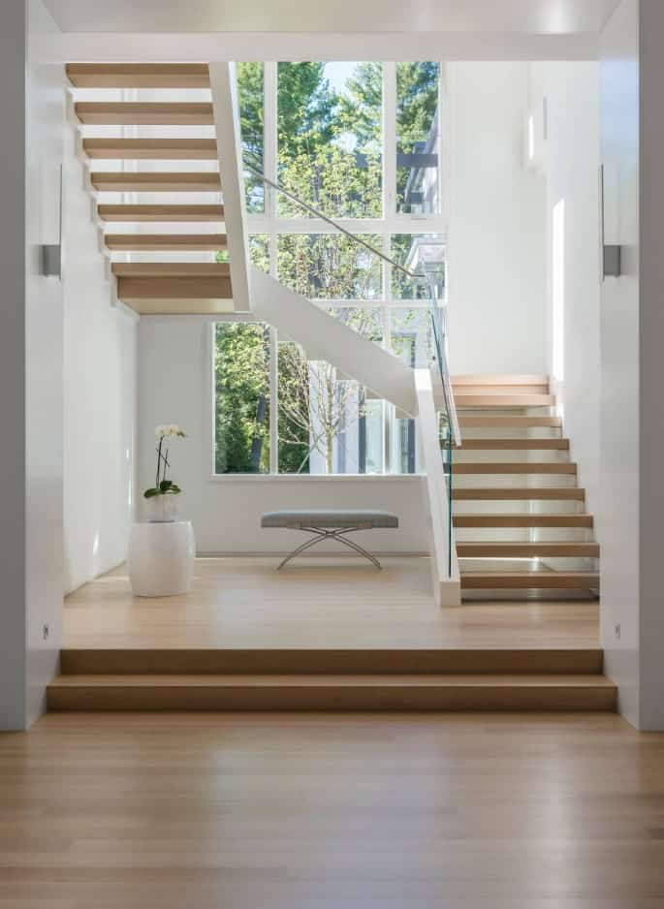
Three quarter turn stairs
A stair turning through three right angles is known as a three quarter turn stair.
This type of stair is used when the length of the stair is limited and when the vertical distance between the two floors is quite large.

Slide 54
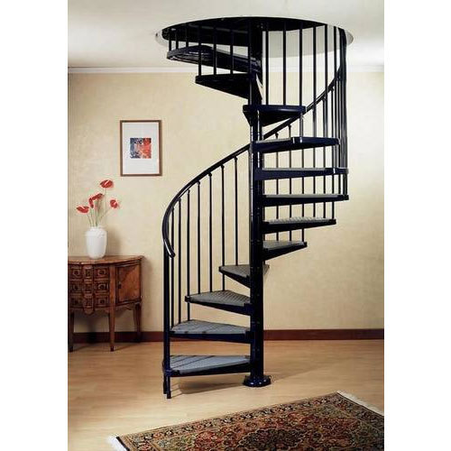
CIRCULAR OR HELICAL OR SPIRAL STAIRS
The flights consists of winders only and they may be continued through any desired number of turns.
A spiral stair may be constructed of cast iron, mild steel or concrete.
For concrete spiral stairs the steel reinforcement is heavy and formwork is complicated.
The core of stair may be solid or hollow and stair may be provided with cut or closed strings.

Slide 55
GEOMETRICAL STAIRS
These stairs have any geometrical shape and they require no newel posts. The handrail of the geometrical stair continuous without any interruption and without any angular turns.

Slide 56
FLOORING
Purpose of flooring is to get a good hard, level and beautiful surface for living.
The floors directly resting on the ground are known as ground floors while the floors of each storey are known as upper floors.

Slide 57
GROUND FLOOR
Apart from giving good finished surface, these floors should have good damp resistance.
The ground surface is rammed well and a layer of red earth or sand is placed which is compacted.
A layer of broken bricks, stones etc. is provided up to 150 mm below floor finish level and rammed.
While ramming the surface is kept moist to get good compaction.
Then 1 : 4 : 8 concrete of 100 to 150 mm thickness is provided as base course. Over this bed floor finish is laid.

Slide 58
The types of Flooring used are
Mud and moorum
Brick
Flag stone
Cement concrete
Terrazzo
Mosaic
Marble
Tiles
Timber
Rubber
P.V.C.

Slide 59
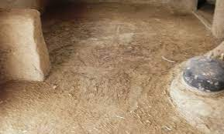
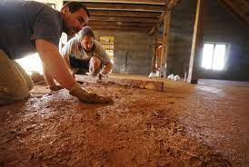
Mud and moorum

Slide 60
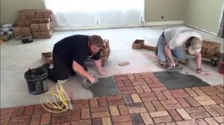
BRICK FLOORING

Slide 61
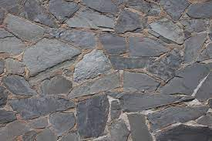
Flag stone

Slide 62
Cement concrete
It is modestly cheap and durable floor and hence commonly used in residential, commercial and industrial buildings.
It consists of two courses-base course and wearing coat. Base course is laid over well compacted soil. Its thickness is usually 75 mm to 100 mm.
It consists of lean cement concrete mix (1 : 4 : 8) or lime concrete containing 40% of 1 : 2 lime mortar and 60% of coarse aggregate of 40 mm size.

Slide 63
After base coarse is hardened wearing coat of 40 mm is laid.
It consists of panels of 1 m × 1 m, 2 m × 2 m or 1 m × 2 m.
Alternate panels are laid with 1 : 2 : 4 concrete using wooden, glass or asbestos strip separators of 1.5 mm to 2.0 mm thickness.
To get good bond between base coarse and wearing coat cement slurry wash is given before laying wearing coat panels.

Slide 64
After 3–4 days of laying of one set of panel, another alternate panels are laid.
Top of these panels are finished by tamping the surface with wooden floats and tapping with trowels, till cement slurry appears on top.
It needs curing for 7 to 14 days. To get good appearance many times red-oxide finishing coat is provided.

Slide 65
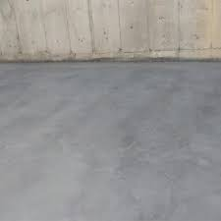
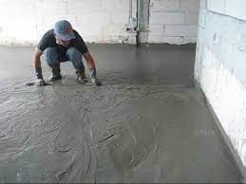

Slide 66
TERRAZZO
Terrazzo finishing coat is applied over concrete flooring to get pleasing appearance. Terrazzo finish consists of 75 to 80% of surface marble chips embedded in cement mortar.
Marble chips are mixed in cement in the proportion 1 : 1.25 to 1 : 2 and about 6 mm terrazzo topping is laid.
The top is tamped and rolled. Additional marble chips are spread during tamping to get proper distribution of marble chips on the surface.
After drying it for 12 to 20 hours, it is cured for 2–3 days.

Slide 67
Then grinding is made in the following three steps:
Ist grinding — Using coarse grade (No. 60) carborundum stones.
IInd grinding — Using medium grade (No. 120) carborundum stones.
IIIrd grinding — Using fine grade (No. 320) carborundum stones.
water is used during grinding.
After each grinding cement grout of cream-like consistency is applied and cured for 6–7 days.
After final grinding and curing the floor is washed with water and then with dilute oxalic acid solution. Then floor is finished with polishing using machines and wax polish.

Slide 68
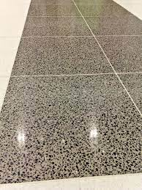
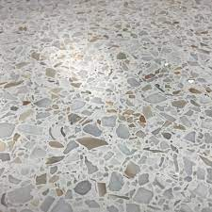
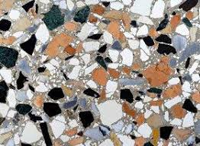

Slide 69
MOSAIC
It consists of a finishing coat of small pieces of broken tiles of China glazed or of marble arranged in different patterns set in lime-surkhi or cement mortar.
The base coarse is concrete flooring and on it 30 to 40 mm mortar layer is provided.
On this mortar layer, broken pieces of China glazed or marble are set to get different attractive patterns.
After 20 to 24 hours of drying the top is rubbed with carborundum stone to get smooth and polished surface.

Slide 70
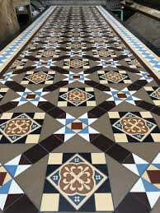


Slide 71
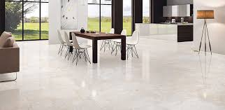
MARBLE
Marble slabs are cut to get marble tiles of 20 to 25 mm thickness. They are laid on floors similar to other tiles. With power driven machine surface is polished to get even and shining surface. This type of flooring is widely used in hospitals and temples.

Slide 72
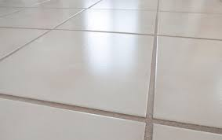
TILES

Slide 73
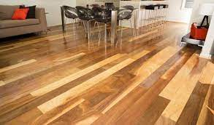
TIMBER

Slide 74
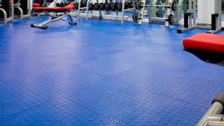
RUBBER

Slide 75
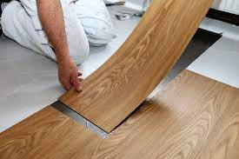
P.V.C

Slide 76
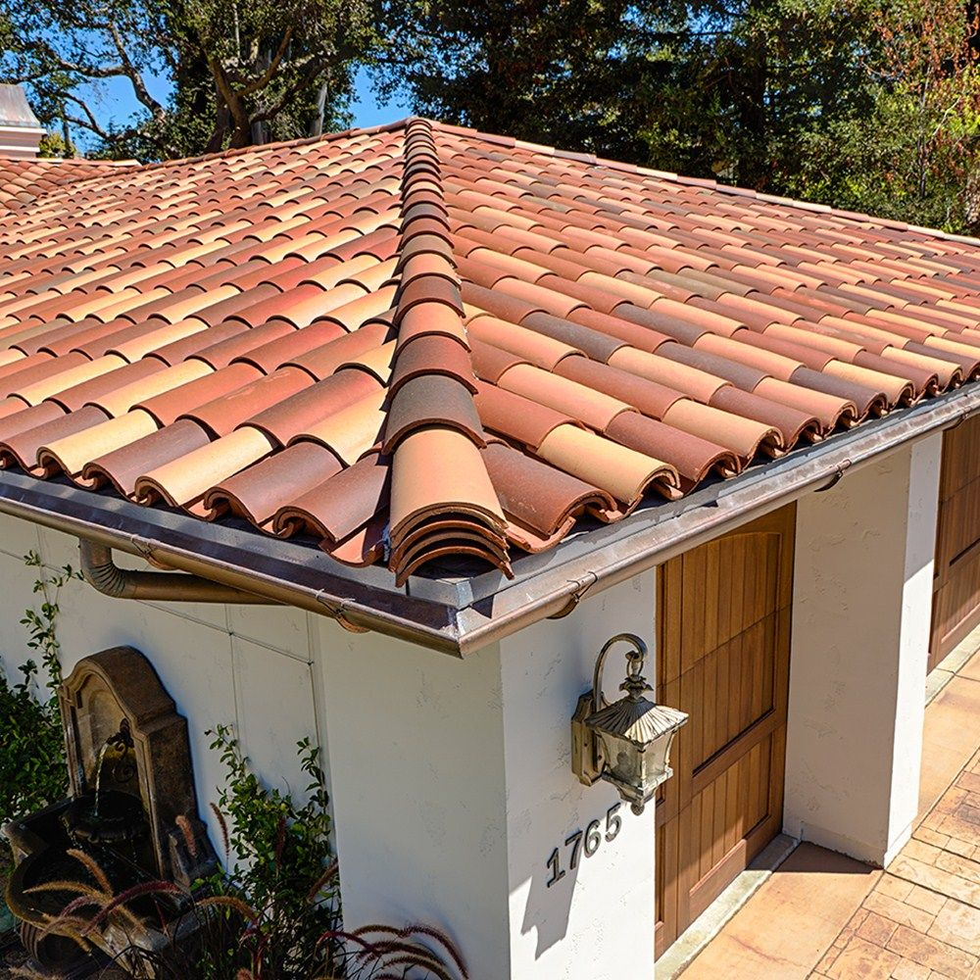
ROOFS
Roof is defined as the uppermost part of a building which is constructed in the form of a framework to give protection to the building against rain, heat, snow, wind etc.
The roof and roof coverings receive rain and snow more directly and in much quantity as compared with walls.
It is essential to provide a positive barrier for the entry of moisture in the building.

Slide 77
Requirements of a good roof
Durable against various agencies i.e. wind, rain, sun, etc.
Desirable insulation against sound and heat.
Good drainage arrangement
Efficient water proofing arrangement.
Should be fire resistant.

Slide 78
DIFFERENT TYPES OF ROOFS
The roofs are classified into the following three categories
Pitched or sloping roofs
Flat or terraced roofs
Curved roofs

Slide 79
PITCHED ROOFS
The pitched roofs have sloping top surface and they are useful at places where rainfall or snowfall is heavy.
single roofs
Double or purlin roof
Trussed roofs

Slide 80
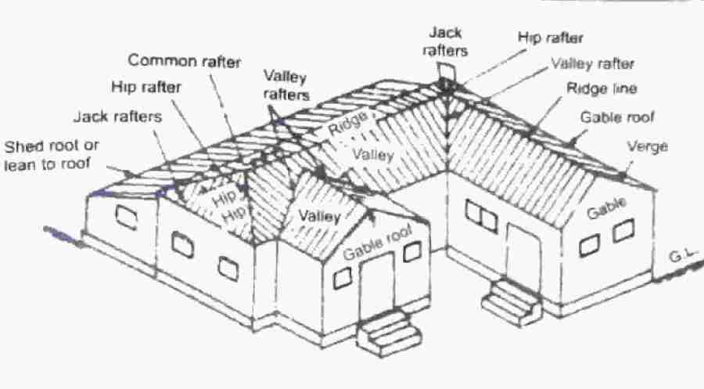
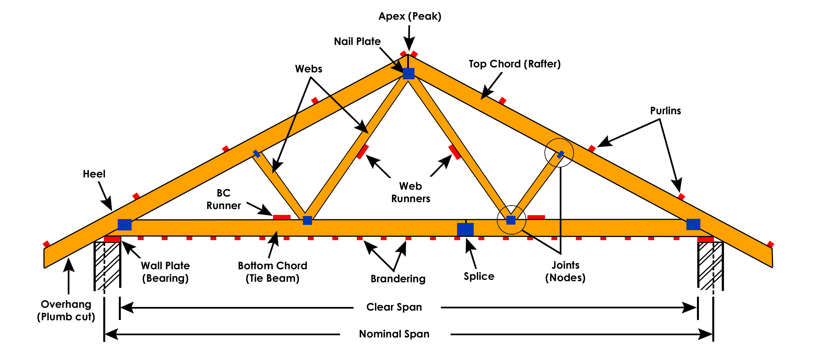
PITCHED ROOF

Slide 81
SINGLE ROOFS
In this type of roofs, the common rafters are provided to each slope without any intermediate support.
Lean to roof
Couple roof
Couple close roof
Couple beam roof
Collar and scissors roof.

Slide 82

LEAN-TO ROOF
Rafter slope to one side only.
Upper ends – rafters are fixed by nails to the wooden plates.
Lower ends – rafters are notched and nailed to the wooden post plate.
Battens are placed and fixed over rafters.
Roof covering materials.
Spans upto 2.5 m.

Slide 83

COUPLE ROOFS
It is formed by a pair of inclined rafters, centre ridge piece and wall plate for supporting the whole roof.
Battens are supported on common rafters and roofing material on battens.
Span of couple roof is limited to 3.5m.

Slide 84

TRUSSED ROOFS
A number of straight members connected in the shape of a triangle and forming a frame is known as truss.
Truss are provided at regular interval of about 3m along the length.
Used for span more than 5m.

Slide 85

King post truss
King post - central post.
Struts – inclined members.
Principal rafters – support the purlins.
Span – 5 to 8 m.

Slide 86

Queen post truss
2 vertical posts
Staining beam
2 struts
Straining sill
Span – 8 to 12 m.

Slide 87

FLAT ROOFS
It is one which is either horizontal or horizontal with slope less than 10°.
Types of flat roofs:
Madras terrace roofs
Reinforced cement concrete slab roof.

Slide 88

CURVED ROOFS
Modification of pitched roof and are frequently employed in modern age to cover large areas.
Useful for assembly halls recreation centres, factories, monumental works.
Pleasing appearance.
Types:
Shell roofs
Domes.

Slide 89
DOORS AND WINDOWS

Slide 90
DOOR
An openable barrier secured in wall opening.
A door is provided to give as access to inside of a room of a building.
Basically, a door consists of two parts : a) door frame b) door shutter.

Slide 91

TECHNICAL TERMS OF DOORS

Slide 92
SIZES OF DOORS
The common width – height relations,
Width = 0.4 to 0.6 height.
Height = (width + 1.2) meters.
doors of residential buildings
External door : (1.0 m X 2 m) to (1.1 m X 2 m)
Internal door : (0.9 m X 2 m) to (1 m X 2 m)
Doors for bathrooms and water closets : (0.7 m X 2 m ) to (0.8 m X 2 m).
Garages for cars : 2.25m (height) X 2.25 m (width) to 2.25m (height) X 2.40 m (width)

Slide 93
SIZES OF DOORS
Public buildings, such as schools, hospitals, libraries etc.
1.2m x 2.0m.
1.2m x 2.1m.
1.2m x 2.25m.

Slide 94
Recommended dimensions for Doors
S.No | Designation | Size of opening (mm) | Size of door frame (mm) | Size of Door shutter (mm)
1 | 8 DS 20 | 800 x 2000 | 790 x 1990 | 700 x 1905
2 | 8 DS 21 | 800 x 2100 | 790 x 2090 | 700 x 2005
3 | 9 DS 20 | 900 x 2000 | 890 x 1990 | 800 x 1905
4 | 9 DS 21 | 900 x 2100 | 890 x 2090 | 800 x 2005
5 | 10 DS 20 | 1000 x 2000 | 990 x 1990 | 900 x 1905
6 | 10 DS 21 | 1000 x 2100 | 990 x 2090 | 900 x 2050
7 | 12 DS 20 | 1200 x 2000 | 1190 x 1990 | 1100 x 1905
8 | 12 DS 21 | 1200 x 2100 | 1190 x 2090 | 1100 x 2005

Slide 95
TYPES OF DOORS
Battened and ledged doors
Battened, ledged and braced doors
Battened, ledged and frames doors
Battened, ledged, braced and framed doors
Framed and panelled doors
Glazed or sash doors
Flush doors
Louvered doors

Slide 96
TYPES OF DOORS
Revolving doors
Sliding doors
Swing doors
Collapsible steel doors
Rolling steel shutter doors

Slide 97

Battened and ledged door

Slide 98

Battened, ledged and braced doors

Slide 99

Battened, ledged and framed doors

Slide 100

Battened, ledged, braced and framed doors

Slide 101

Framed and panelled doors

Slide 102

Glazed or sash doors

Slide 103

Flush doors

Slide 104

Louvered doors

Slide 105

Revolving door

Slide 106

Sliding doors

Slide 107

Swing doors

Slide 108

Collapsible steel door

Slide 109

Rolling steel door

Slide 110
WINDOWS
A window is a vented barrier secured in a wall opening.
The function of a window is to admit light and air to the building and to give a view to the outside.
Two parts: a) window frame, b) window shutters held in position by the window frame.

Slide 111
Recommended dimensions for windows
S.No | Designation | Size of opening (mm) | Size of window frame (mm) | Size of window shutters (mm)
1 | 6 WS 12 | 600 X 1200 | 590 X 1190 | 500 X 1100
2 | 10 WT 12 | 1000 X 1200 | 990 X 1190 | 460 X 1100
3 | 12 WT 12 | 1200 X 1200 | 1190 X 1190 | 560 X 1100
4 | 6 WS 13 | 600 X 1300 | 590 X 1290 | 500 X 1200
5 | 10 WT 13 | 1000 X 1300 | 990 X 1290 | 460 X 1200
6 | 12 WT 13 | 1200 X 1300 | 1190 X 1290 | 560 X 1200

Slide 112
TYPES OF WINDOWS
Fixed windows
Pivoted windows
Double hung windows
Sliding windows
Casement windows
Sash windows
Louvered windows
skylights
Metal windows
Bay windows
Clerestory windows
Corner windows
Dormer windows
Cable windows
Lantern windows

Slide 113

Fixed windows

Slide 114

Pivoted windows

Slide 115

Double hung windows

Slide 116

Sliding windows

Slide 117

Casement windows

Slide 118

Sash or glazed windows

Slide 119

Louvered windows

Slide 120

Metal windows

Slide 121

Bay windows

Slide 122

Corner windows

